Slide 1
Information Politics: Using Machine Learning to Assess Amnesty International Human Rights Reporting
University of Georgia 05/02/17
School of Public and International Affairs
POLS8500: Applied Machine Learning
Sarah Hunter, Lucas Nussbaumer

Slide 2

Research Question
Are there distinct topics discussed in AI reports in states with and without violent protest?

Slide 3
The Problems of Human Rights Reporting
Unstable Information Environment
AI is a strategic Actor
Normative goals v. Organizational incentives
Problems of reporting on domestic protest
Domestic protest is a sign of an empowered public to fight against human rights abuses
AI's tools were developed to specifically target states
Media Profile
Donors
Yet,states are not the only abusers of human rights
"Conflicting Incentives"
AI is expected to comment on human rights abuses
Difficult to verify reports
Reporting on human rights
Human rights violations happen in areas with out access to reliable information

Slide 4
Hypotheses
H₁: The presence of a violent anti-government protest will be a significant indicator of topic choice in Amnesty International reporting on human rights.
H₂: Amnesty International will use different topics when discussing the human rights of democracies versus autocracies.

Slide 5
Data
Amnesty International Background Reports
Africa 2000-2017
Summaries
Social Conflict and Action Database (SCAD)
African Countries
2000-2015
Cingranelli and Richards Human Rights Index (CIRI)
Polity IV

Slide 6

Methods
Two Sets of Documents
Classified via SCAD („etype“: Anti-Government Violence)
Topic Models
Latent Dirichlet Allocation (LDA)
"topicmodels" R package
Logitistic Regression
Topic as DV

Slide 7
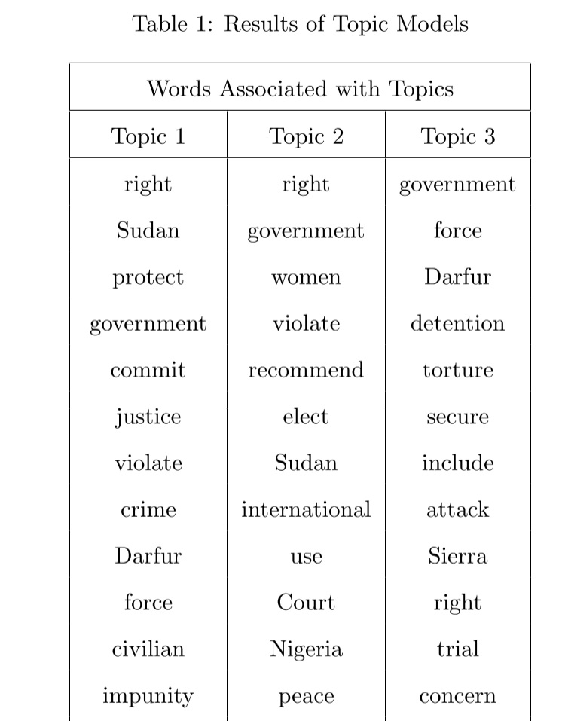
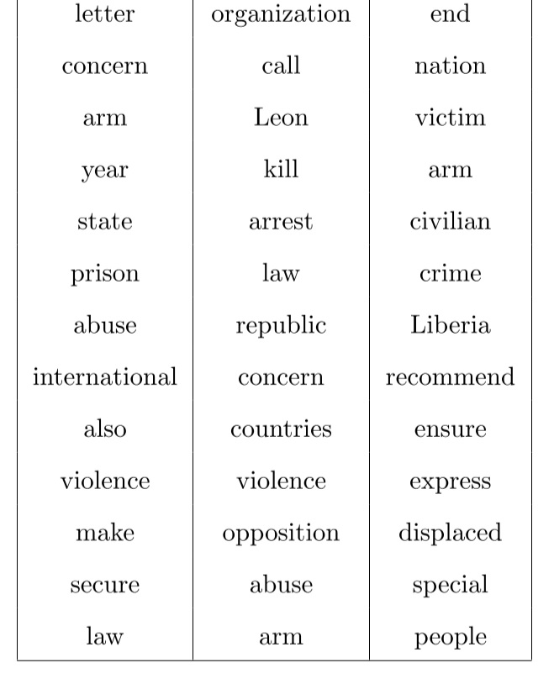
Topics
Topic 1: Government abuse of human rights
Topic 2: Public Dissent
Topic 3: Post-conflict struggles

Slide 8
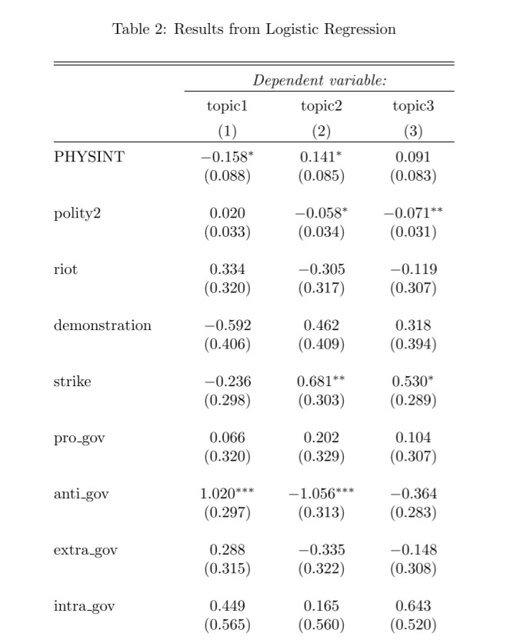
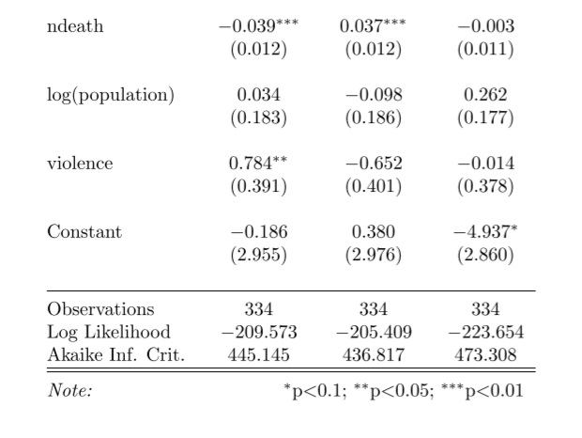
Logit Models
Pr(Document = TopicX) = β0 + β1(PHY SINT) + β2(polity2) + β3(riot) + β4(demo) + β5(strike) + β6(pro_gov) + β7(anti_gov) + β8(ndeath) + β9(log_pop) + β10violence

Slide 9
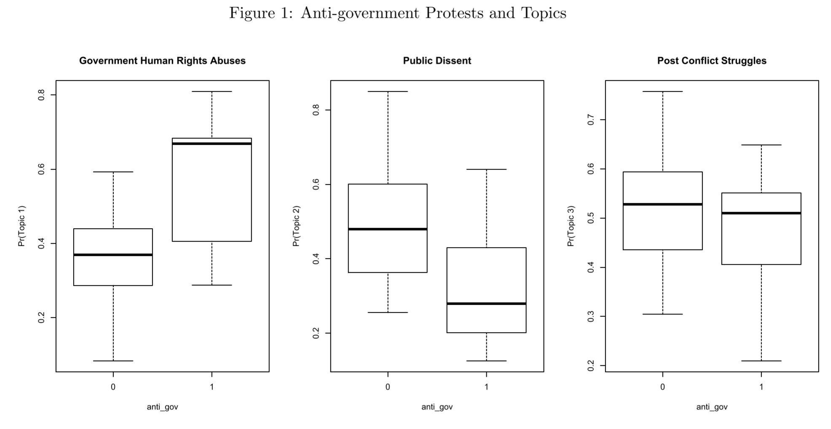
Anti-government Protest

Slide 10
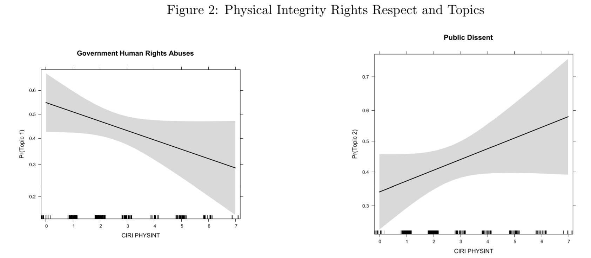
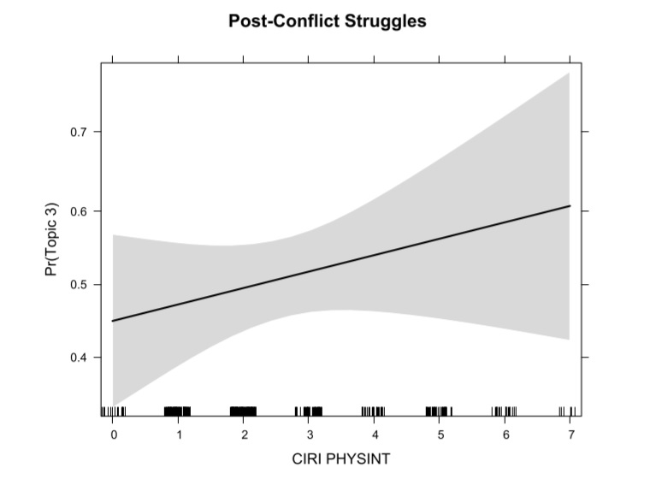
Physical Integrity Rights Respect

Slide 11
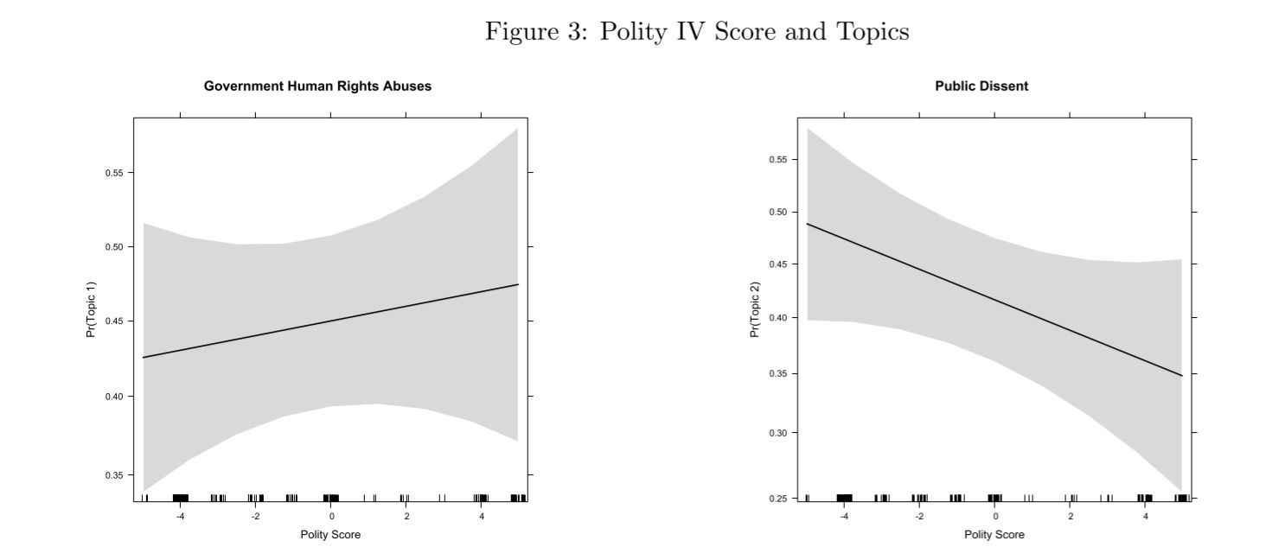
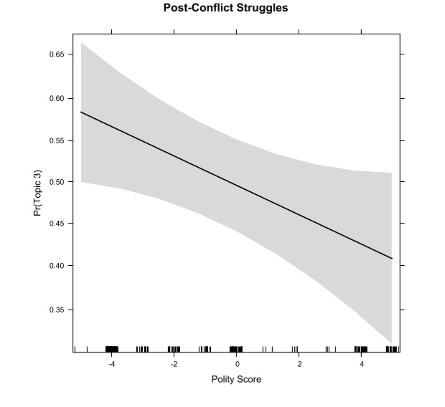
Polity IV

Slide 12
Conclusion
Accurate human rights reporting does not mean unbiased
Domestic protest does matter how Amnesty International reports human rights abuses
There are differences in the types of domestic protest in how human rights practices are reported
Regime type also matters for how Amnesty International reports on states' human rights practices

Slide 13
Future Directions
More data (1990-1999)
NGO presence
Time span – NGO Watchdog vs. Amnesty International
Algorithm
Reporting and different types of protest

Slide 14
References
Bob, C. (2005). Marketing Rebellion. Cambridge: Cambridge University Press.
Cooley, A. and Ron, J. (2002). “The NGO Scramble: Organizational Insecurity and the Political Economy of Transnational Action.” International Security 27(1): 5-39.
Hill, D. W., Moore, W. H. and Mukherjee, B. (2013). “Information Politics Versus Organizational Incentive: When Are Amnesty International’s “Naming and Shaming” Reports Biased?” International Studies Quarterly 57(2): 219-232.
Murdie, A. and Bhasin, T. (2011). “Aiding and Abetting: Human Rights INGOs and Domestic Protest.” Journal of Conflict Resolution 55(2): 163-191.

